Slide 1
Developing and Distributing Custom Visuals
Notes:
Understanding the Power BI Visuals API - Defining Data Roles and Data Mappings - Advanced Custom Visual Design Features - Extending a Visual with Custom Properties - Packaging and Deploying Custom Visuals

Slide 2
Agenda
Working with the Custom Visual Toolchain
Defining Data Roles and Data Mappings
Extending a Visual with Custom Properties
Designing Custom Visuals using a View Model
Advanced Custom Visual Design Features
Packaging and Deploying Custom Visuals

Slide 3
Install the Power BI Developer Toolchain
Install Node.JS
Installs Node Package Manage (npm)
Install Visual Studio Code
Lightweight Alternative to Visual Studio for Node.js Development
Install Power BI visuals CLI tool (pbiviz)
Install using Node Package Manager (npm)
Install Local self-signed certificate
Install using Power BI visuals CLI tool (pbiviz)

Slide 4
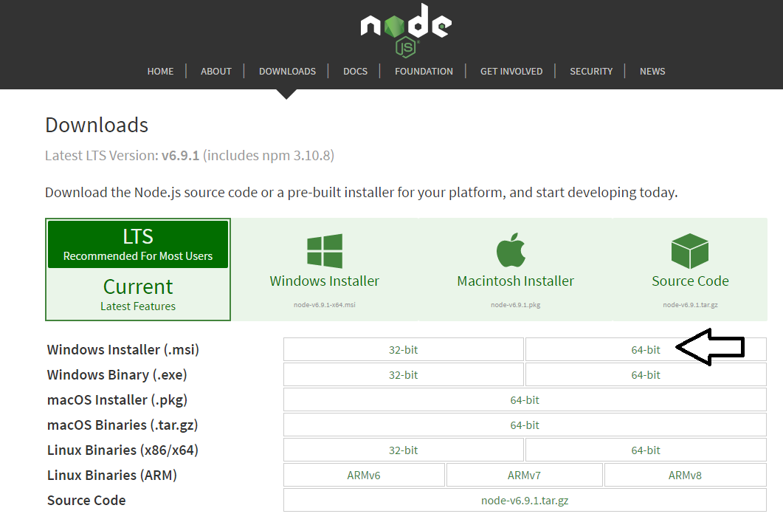
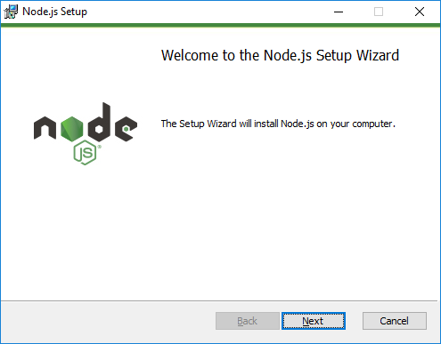
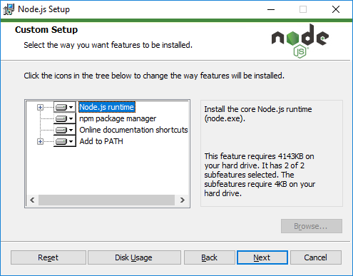
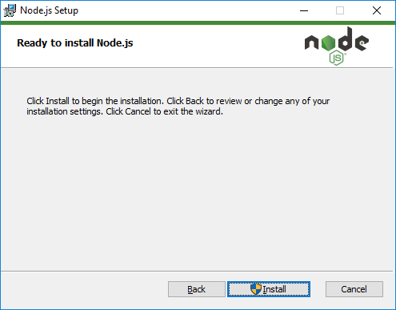
Installing node.js
https://nodejs.org/en/download/

Slide 5
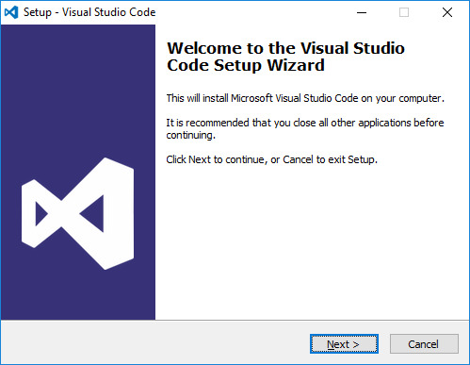
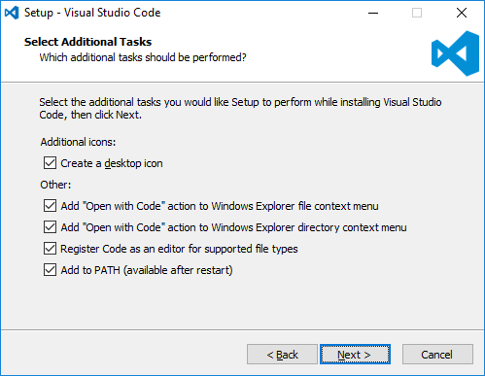
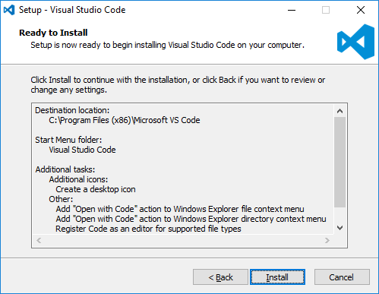
Install Visual Studio Code
http://code.visualstudio.com/

Slide 6
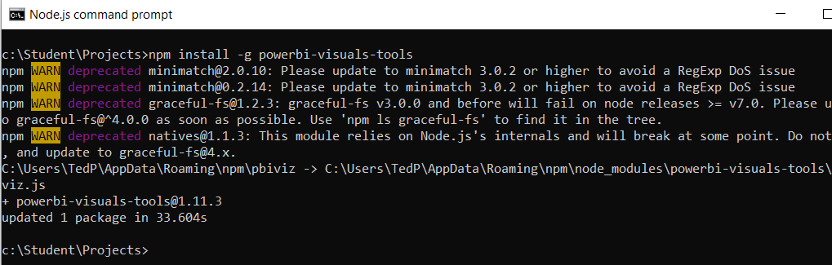
Power BI Visual CLI Tool (PBIVIZ)
What is the Power BI Custom Visual Tool?
Command-line utility for cross-platform dev
Use it with Visual Studio or Visual Studio Code
Requires that you first install node.js
Install by running command from node.js command prompt
npm install -g powerbi-visuals-tools

Slide 7
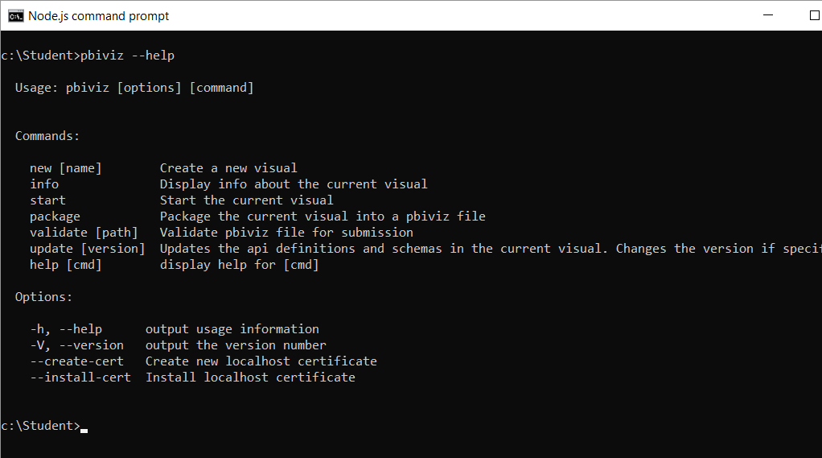
Getting Started with PBIVIZ
PBIVIZ.EXE is a command-line utility
You execute PBIVIZ commands from the NODE.JS command line

Slide 8
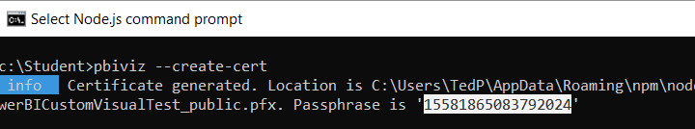
Creating a Certificate for Local Testing
PBIVIZ provide local web server for testing & debugging
Web server runs locally on developer's workstation in Node.js
Makes it possible to test custom visuals in Power BI Service
Custom visual resources served up from https://localhost
Setup requires creating self-signed SSL certificate
SSL certificate created using pbiviz --create-cert command
You must copy a passphrase to properly install the certificate

Slide 9
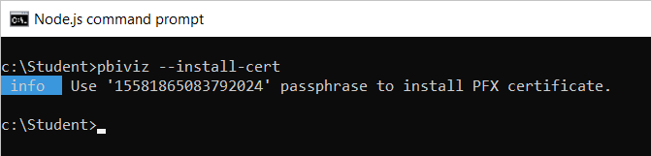
Installing the SSL Certificate
Installing certificate enables SSL through https://localhost
Installing certificate is a one time operation – not once per project
SSL certificate installed using pbiviz --install-cert command
Running --install-cert command starts Certificate Import Wizard

Slide 10
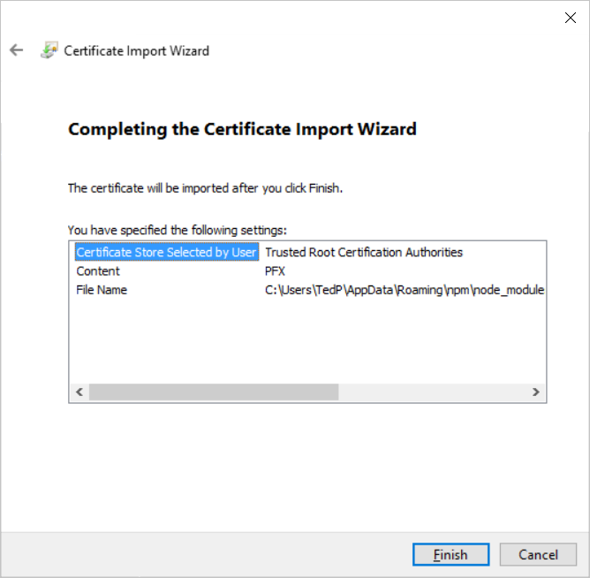
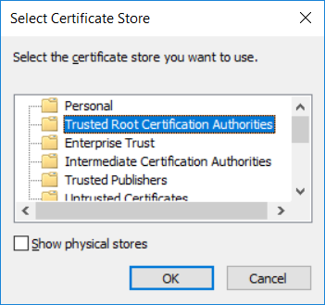
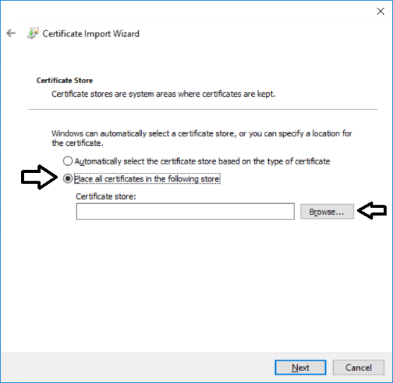
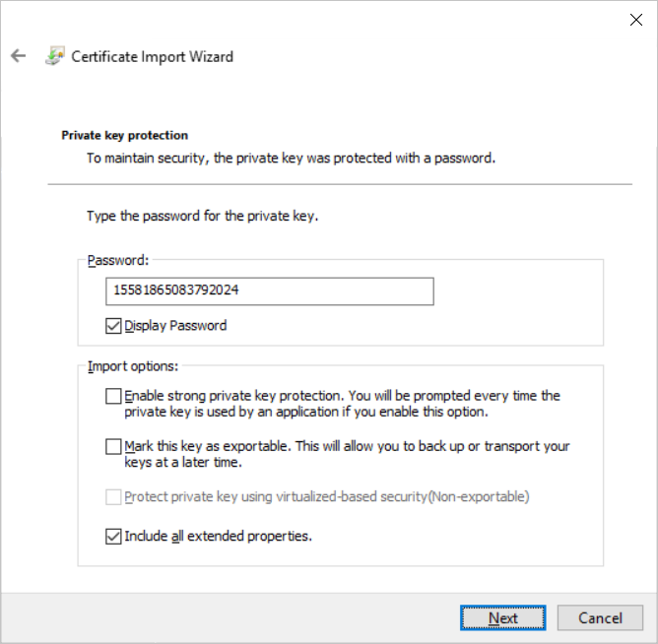
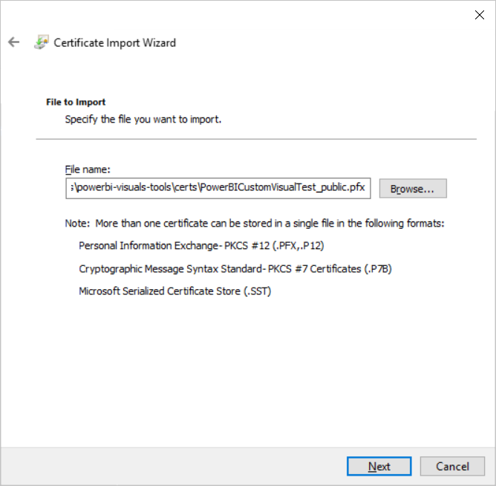
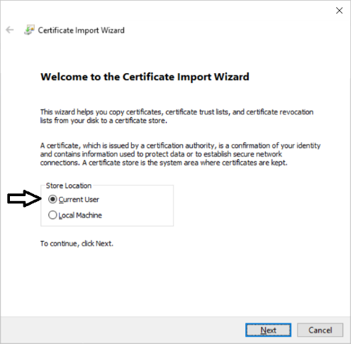

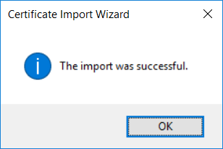
The Certificate Import Wizard
Wizards steps you through process of installing certificate
You enter certificate passphrase as part of installation process

Slide 11
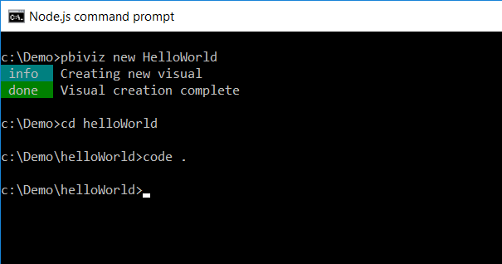
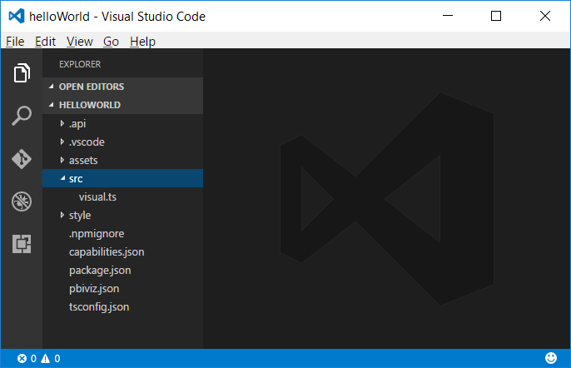
Creating a New Custom Visual Project
Creating a new project
pbiviz new <ProjectName>
Open the Project with Visual Studio Code
code .

Slide 12
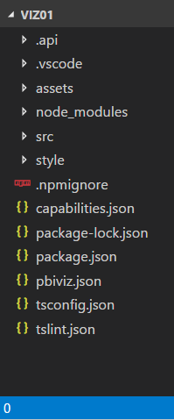
Files in the new project
package.json
Used by npm to manage package
pbiviz.json
Main manifest file for your custom visual project
capabilities.json
File used to define visual capabilities
tsconfig.json
Typescript compiler settings

Slide 13
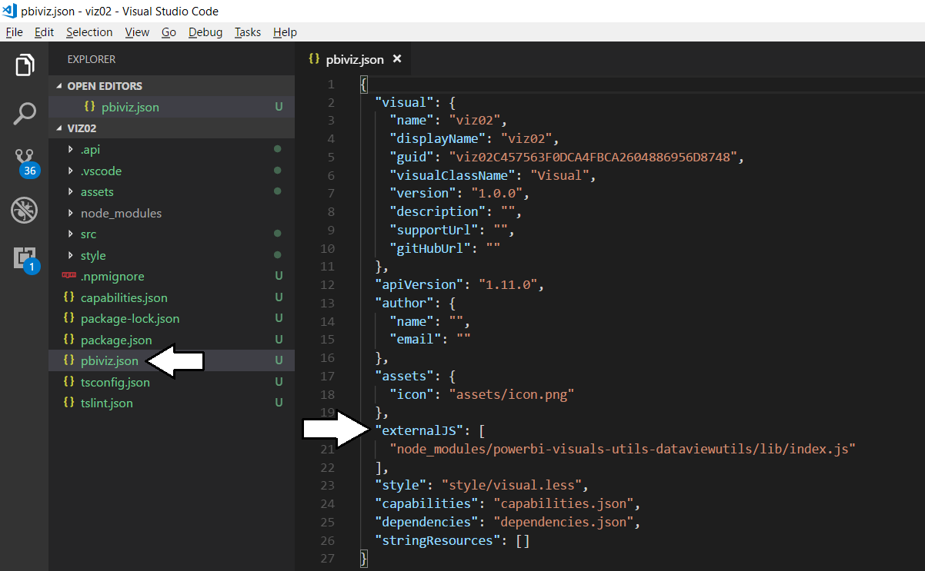
The pbiviz.json File
Acts as top-level manifest file for custom visual project
External JS library files must be referenced in externalJS section

Slide 14
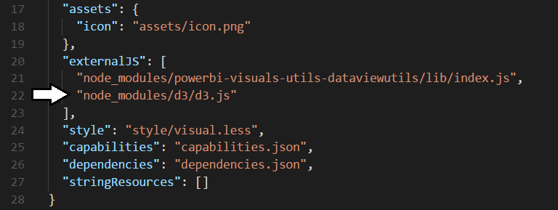
Installing Support for D3
Install package for D3 library version 3
npm install d3@3 --save-dev
Install package for type definition files version 3
npm install @types/d3@3 --save-dev
Update externalJS section of pbiviz.json

Slide 15
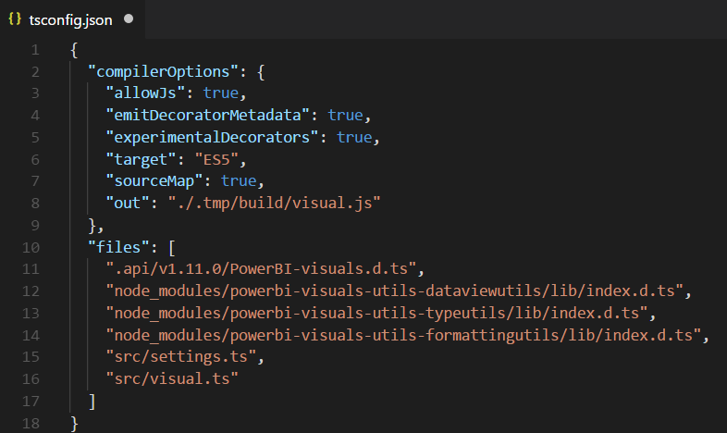
The tsconfig.json File
Used to add references to other TypeScript files
Controls which TypeScript files are passed to TypeScript compiler
No need to reference *.d.ts files in the node_modules/@types folder

Slide 16
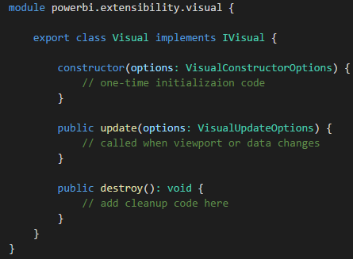
Authoring a Custom Visual Class
Custom visual is a class that implements IVisual
Class must be defined in powerbi.extensibility.visual namespace
Minimum visual class must provide update method
Constructor and other lifecycle methods can be added

Slide 17
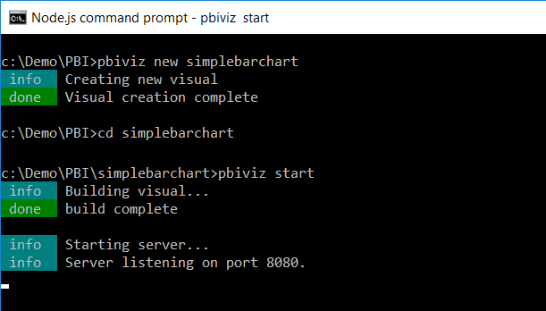
Running a Custom Visual Project
Visual projects run & tested using pbiviz start command
Command starts local debugging session in node.js.
Provides ability to run custom visual in the Power BI Service

Slide 18
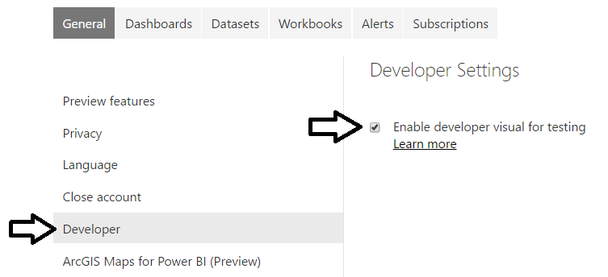
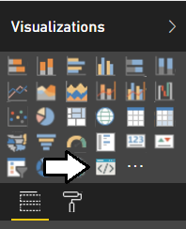
The Developer Visual
Must be enabled on Developer Settings page
Provides new visual for testing and debugging custom visuals

Slide 19
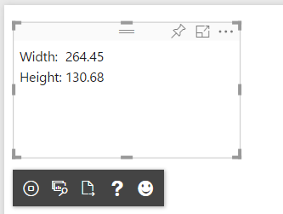
Working with the Developer Visual
Developer visual loads custom visual from node.js
Makes it possible to test custom visual inside Power BI Service
Developer visual provides toolbar with development utilities

Slide 20
Agenda
Working with the Custom Visual Toolchain
Defining Data Roles and Data Mappings
Extending a Visual with Custom Properties
Designing Custom Visuals using a View Model
Advanced Custom Visual Design Features
Packaging and Deploying Custom Visuals

Slide 21
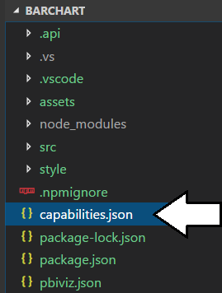
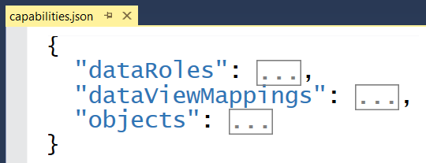
Visual Capabilities
Visual capabilities defined inside capabilities.json
dataRoles defines the field wells displayed on Fields pane
dataViewMappings defines the type of DataView used by visual
objects defines custom properties for visual

Slide 22
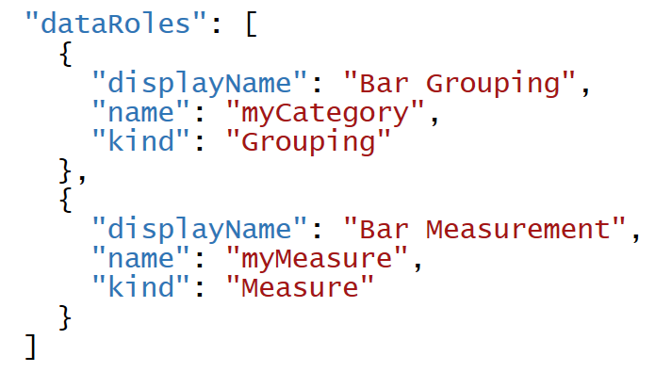
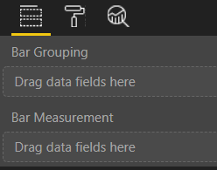
Data Roles
DataRoles define how fields are associated with visual
Each dataRole is display as field well in the Field pane
dataRoles can be defined with conditions and data mappings

Slide 23
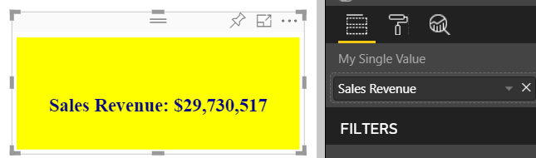
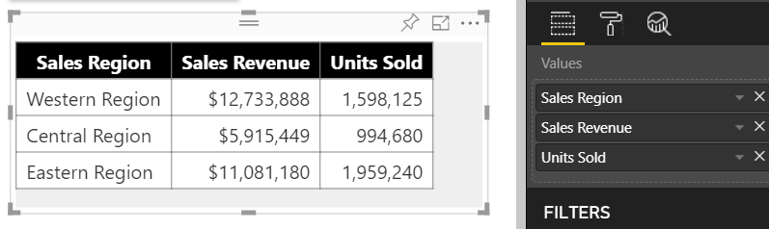
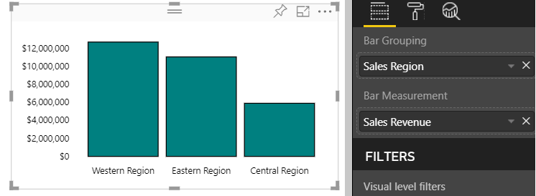
Data Mapping Modes
Power BI visual API provides several mapping modes
Single
Table
Categorical
Matrix
Tree
Single Mapping
Table Mapping
Categorical Mapping

Slide 24
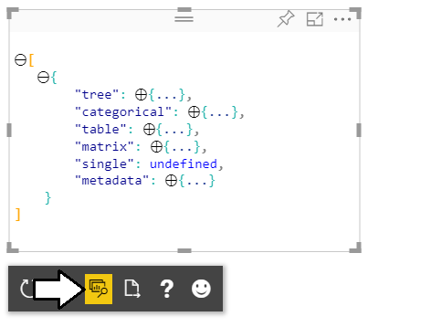
Developer Visual DataView
Developer visual supports DataView mode
Allows you to see and explore data mapping
Allows you to see metadata for custom properties

Slide 25
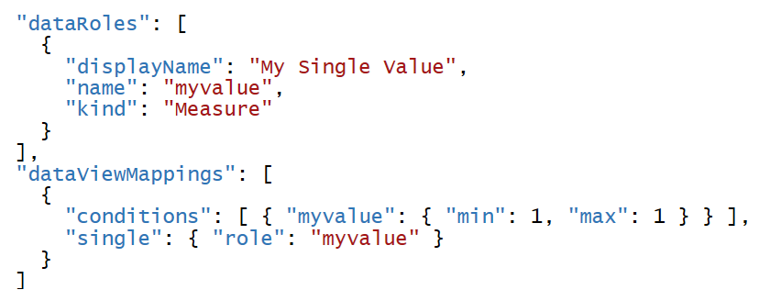
Single Mapping Example: oneBigNumber
dataRole can use dataViewMapping mode of single
For visuals like Card which only display single value
Condition can define that a dataRole requires exactly one measure

Slide 26
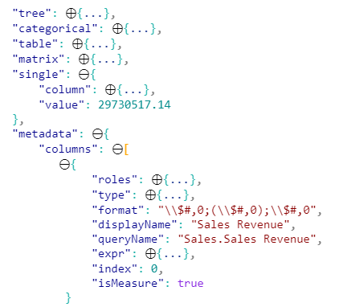
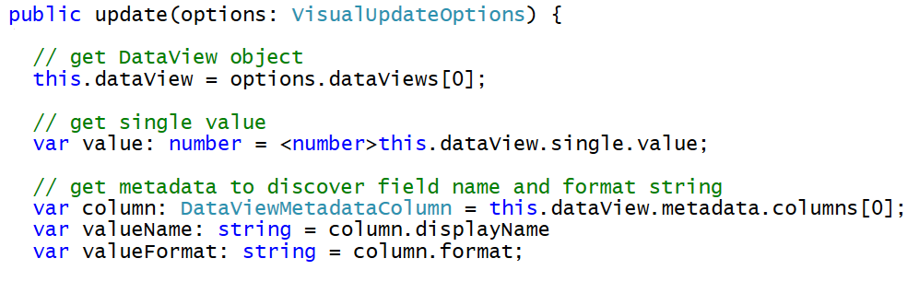
Programming in Single Mapping Mode
Single mapping easy to access through visuals API
DataView object provides single.value property
value property defined as PrimativeValue { bool | number | string }
PrimativeValue must be explicitly cast
Other measure properties available through column metadata

Slide 27
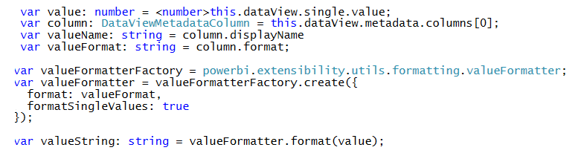
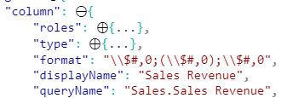
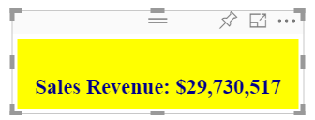
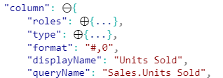
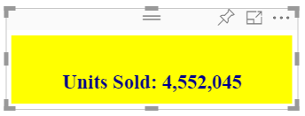
Using the Power BI Formatting Utilities
Used to format values using Power BI formatting strings
Requires installing powerbi-visuals-utils-formattingutils package

Slide 28
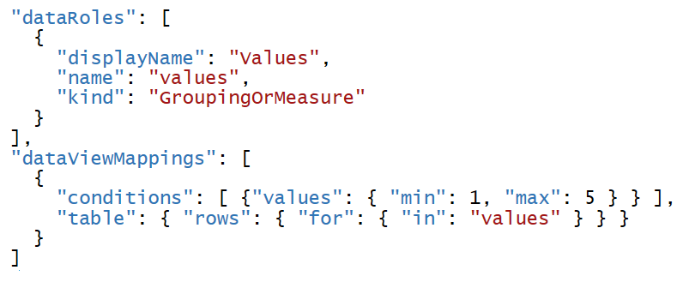
Table Mapping Example: Snazzy Table
dataRole can use dataViewMapping mode of table
For visuals which display rows & columns for ordered set of fields
condition can define number of fields that can be added

Slide 29
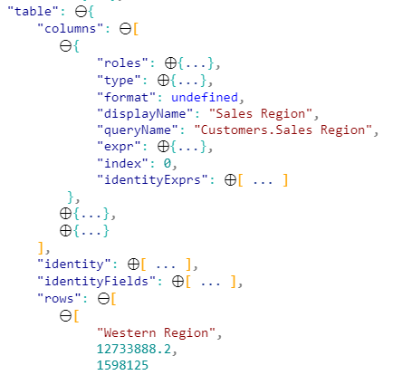
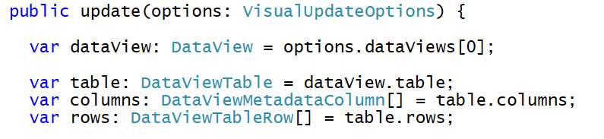
Programming in Table Mapping Mode
Table mapping data accessible through visuals API
DataView object provides table property
table property provides columns property and rows property

Slide 30
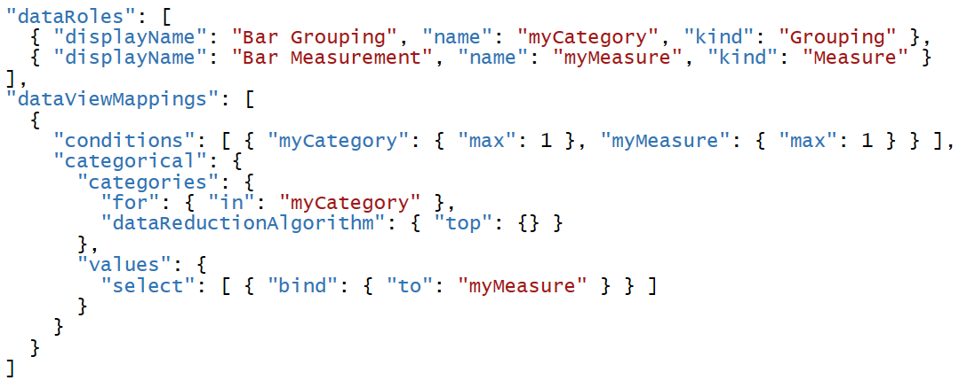
Categorical Mapping Example: Barchart
dataRole can use dataViewMapping mode of categorical
This is the most common type of data mapping
For visuals which divide data into groups for analysis
Groups defined as columns and values defined as measures

Slide 31
Agenda
Working with the Custom Visual Toolchain
Defining Data Roles and Data Mappings
Extending a Visual with Custom Properties
Designing Custom Visuals using a View Model
Advanced Custom Visual Design Features
Packaging and Deploying Custom Visuals

Slide 32
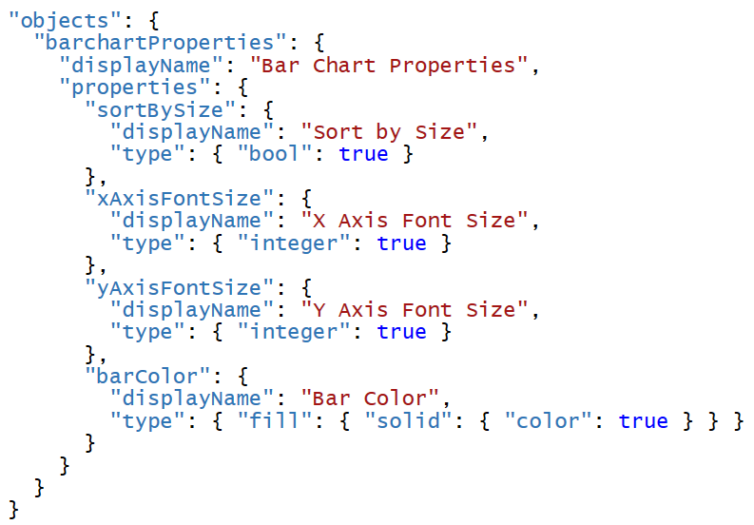

Extending Visuals with Custom Properties
Custom properties defined using objects
You can define one or more objects in capabilities.json
Each object defined with name, display name and properties
object properties automatically persistent inside visual metadata
properties can be seen and modified by user in Format pane
Custom properties require extra code to initialize Format pane

Slide 33

DataViewObjectParser and VisualSettings
Power BI visual utilities provide DataViewObjectParser
Abstracts away tricky code to initialize and read property values

Slide 34
Mapping Object Properties to VisualSettings
VisualSettings class must map to named objectnamed
VisualSetting class contains named field that maps to object name
Named field based on custom class with mapped properties
Object & property names must match what's in capabilities.json

Slide 35

Initializing Objects in the Format Pane
Visual must initialize properties in Format pane
Visual must implement enumerateObjectInstances
VisualSettings makes this relatively easy
Extra code required to make property appear as spinner

Slide 36


Retrieving Property Values
Property values persisted into visual metadata
Properties not persisted white they still retain default values
Property values retrieved using VisualSettings object

Slide 37
Agenda
Working with the Custom Visual Toolchain
Defining Data Roles and Data Mappings
Extending a Visual with Custom Properties
Designing Custom Visuals using a View Model
Advanced Custom Visual Design Features
Packaging and Deploying Custom Visuals

Slide 38

Designing with View Model
Best practice involves creating view model for each visual
View model defines data required for rendering
createViewModel method gets data to generate view model
update method calls createViewModel to get view model

Slide 39
Examining the View Model in the Barchart Visual

Slide 40
Agenda
Working with the Custom Visual Toolchain
Defining Data Roles and Data Mappings
Extending a Visual with Custom Properties
Designing Custom Visuals using a View Model
Advanced Custom Visual Design Features
Packaging and Deploying Custom Visuals

Slide 41
smartieBarChart Demo
Advanced Visual Features
Support for Visual Highlighting
Selection Manager
TooltipsServiceWrapper

Slide 42
Agenda
Working with the Custom Visual Toolchain
Defining Data Roles and Data Mappings
Extending a Visual with Custom Properties
Designing Custom Visuals using a View Model
Advanced Custom Visual Design Features
Packaging and Deploying Custom Visuals

Slide 43

Packaging and Deploying Custom Visuals

Slide 44
Summary
Working with the Custom Visual Toolchain
Defining Data Roles and Data Mappings
Extending a Visual with Custom Properties
Designing Custom Visuals using a View Model
Advanced Custom Visual Design Features
Packaging and Deploying Custom Visuals

